Slide 1

CAPSTONE PROJECT

Slide 2

How does a bike-share navigate speedy success?
DIRECTED
BY
BERILIEN VERNARD
OCTOBER 2024

Slide 3
SUMMARY
This project, part of the Data Analysis program at Merit America, aims to analyze how casual riders and annual members use Cyclistic bike-share services differently, to develop a marketing strategy to increase memberships. Casual riders represent 87% of total rides, typically riding more between Thursday and Sunday, while members ride mainly on Saturdays and Sundays. The analysis challenges the initial hypothesis that annual members ride more frequently due to prepaid subscriptions.

Slide 4
Key recommendations to increase memberships include:
Offering discounts on weekends, particularly for members.
Designing a loyalty program for casual riders.
Leveraging digital media to highlight membership benefits.
Creating a user-friendly app to collect rider information.
Launching marketing campaigns in recreational locations and promoting membership benefits during off-peak months.
These strategies aim to convert casual riders into members and encourage existing members to maintain their subscriptions.

Slide 5
INTRODUCTION AND CONTEXT
This work is part of the Data Analysis program at Merit America. As a data analyst, completing a project at the end of the Capstone program is essential. The primary goal of this project is to earn a Data Analyst certificate. However, it also allows employers to evaluate job-relevant skills and gain insight into how candidates tackle common data-related challenges. This project will be a key component in building our professional portfolio. For the assignment, we will work with a fictional company and key team members to address business questions using data analysis steps: asking, preparing, processing, analyzing, sharing, and acting.

Slide 6
Scenario
As a junior data analyst on the marketing team at Wheelmen, a bike-sharing company in Chicago, the marketing director believes that increasing annual memberships is critical to the company's future success. In this context, our team aims to understand how casual riders and annual members use Cyclistic bikes differently. Based on these insights, we will design a new marketing strategy to convert casual riders into annual members. However, Cyclistic's executives expect us to provide recommendations supported by data analysis and professional data visualizations.

Slide 7
To address this, we will focus on the marketing director's hypothesis and ask the central question of the project:
How does a bike-share navigate speedy success?
To address the main question, we propose the following three key questions to guide the development of Cyclistic’s future marketing strategy:
How do annual members and casual riders use Cyclistic bikes differently?
What factors would motivate casual riders to purchase annual memberships?
How can Cyclistic leverage digital media to encourage casual riders to become annual members?
These questions will form the foundation for our analysis and recommendations

Slide 8
Hypothesis
In the scientific process, a hypothesis can be formulated either at the beginning or during the course of research, as seen in empirical and deductive studies. In this case, we have chosen to proceed with a hypothesis to address Cyclistic's challenges. Following the approach of Maurice Duverger, who views a hypothesis as a response or series of responses to a research problem that will later be verified through a research method, we consider the hypotheses we propose as potential answers to the issues at hand.
The focus of this study is on the question: How can a bike-share company achieve rapid success?
The main hypothesis is broken down into a set of specific assumptions:
Annual members use the service more frequently than casual riders because the prepaid subscription encourages them to take rides more often than if they didn’t have an annual membership.
Cyclistic could introduce a subscription model that is easy to customize and flexible, offering price reductions or promotions for new users.
The company could launch awareness campaigns, such as “The Benefits of Shorter Rides,” to inform the general public and existing casual riders about the advantages of taking shorter trips.

Slide 9
About the company
In 2016, Cyclistic launched a successful bike-share offering. Since then, the program has grown to a fleet of 5,824 bicycles that are geotracked and locked into a network of 692 stations across Chicago. The bikes can be unlocked from one station and returned to any other station in the system at any time.
Until now, Cyclistic’s marketing strategy relied on building general awareness and appealing to broad consumer segments. One approach that helped make these things possible was the flexibility of its pricing plans: single-ride passes, full-day passes, and annual memberships. Customers who purchase single-ride or full-day passes are referred to as casual riders. Customers who buy annual memberships are Cyclistic members.

Slide 10
APPROACH
To answer these questions and provide recommendations for the problem the marketing director seeks to solve, we will follow this process: data collection, data cleaning, data analysis, and finally, drawing conclusions and making recommendations. The data we will use for our analysis will come from the following sources: Divvy_trips2019 and Divvy_trips2020. The data source is publicly accessible and frequently updated, making it a reliable resource for decision-making. To analyze the data, we will use RStudio and Excel. Our analysis will follow a four-step process. The first step is to collect the data, followed by wrangling and combining the data into a single file. Next, we will focus on cleaning the data, and then move on to descriptive analysis and further analysis. All of these tasks will be carried out using Excel and RStudio.

Slide 11
DATA COLLECTION
The data come from Divvy_trips2019 and Divvy_trips2020. which are publicly accessible and frequently updated. The data was collected on September 25 from the link provided below, and we considered only data from twelve consecutive months between 2019 and 2020. The data collected is specifically compatible with RStudio. In the following table, we present various code snippets run in RStudio to gain insights into the dataset, such as the column names and the number of rows and columns.

Slide 12
DATA COLLECTION
q1_2019 <- read_csv("Divvy_Trips_2019_Q1.csv")
Rows: 365069 Columns: 12
q1_2020 <- read_csv("Divvy_Trips_2020_Q1.csv")
Rows: 426887 Columns: 13
colnames(q1_2019)
[1] "trip_id" "start_time" "end_time" "bikeid"
[5] "tripduration" "from_station_id" "from_station_name" "to_station_id"
[9] "to_station_name" "usertype" "gender" "birthyear"
> colnames(q1_2020)
[1] "ride_id" "rideable_type" "started_at" "ended_at"
[5] "start_station_name" "start_station_id" "end_station_name" "end_station_id"
[9] "start_lat" "start_lng" "end_lat" "end_lng"
[13] "member_casual"
colnames(q1_2020)
[1] "ride_id" "rideable_type" "started_at" "ended_at"
[5] "start_station_name" "start_station_id" "end_station_name" "end_station_id"
[9] "start_lat" "start_lng" "end_lat" "end_lng"
[13] "member_casual"

Slide 13
WRANGLE DATA AND COMBINE INTO A SINGLE FILE
To compare the column names of each file, while the names don’t have to be in the same order, they need to match perfectly. We will change the column names in q1_2019 to make them consistent with q1-2020. After combining the two files into a single file, we removed late, long, birth year, and gender fields as this data was dropped beginning in 2020.

Slide 14
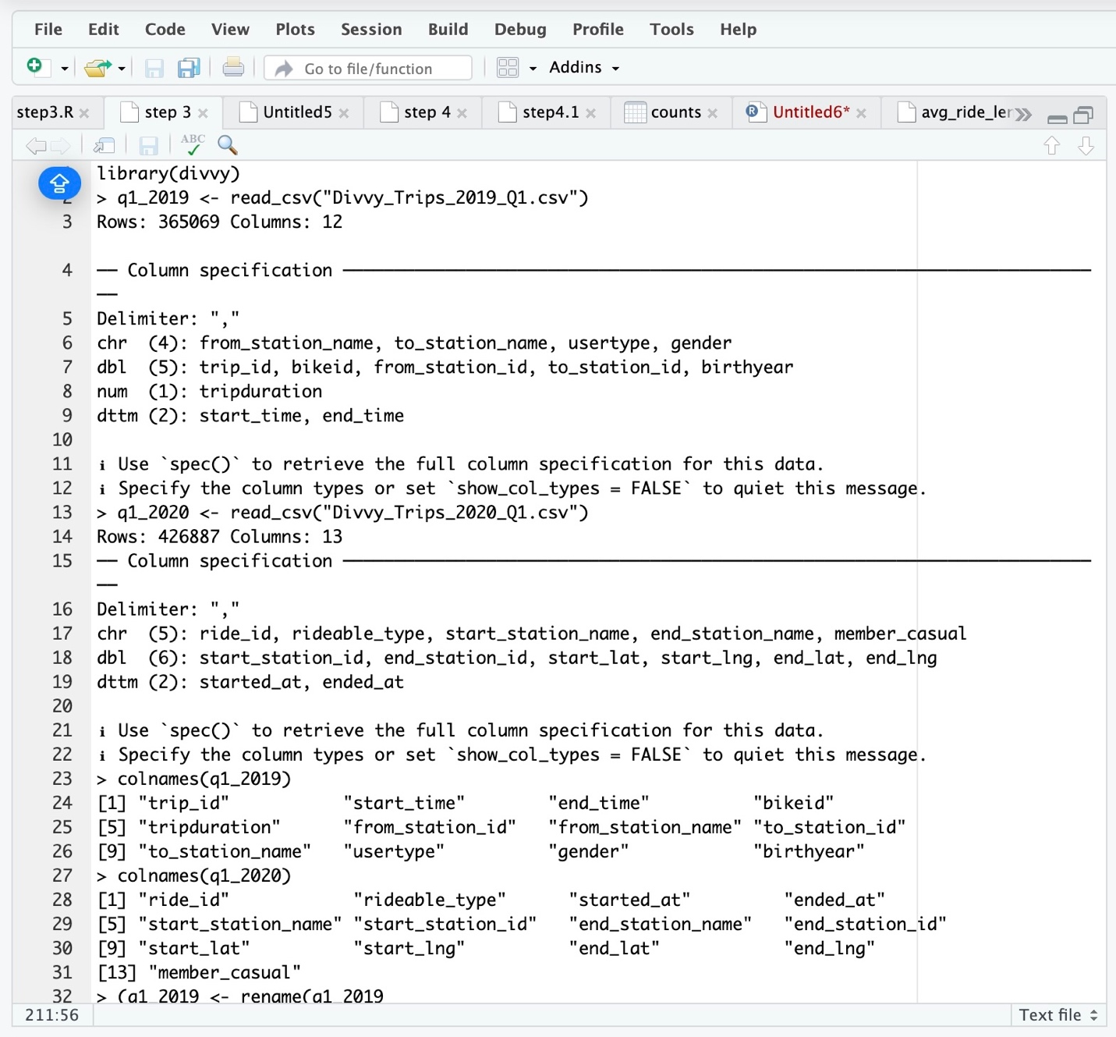
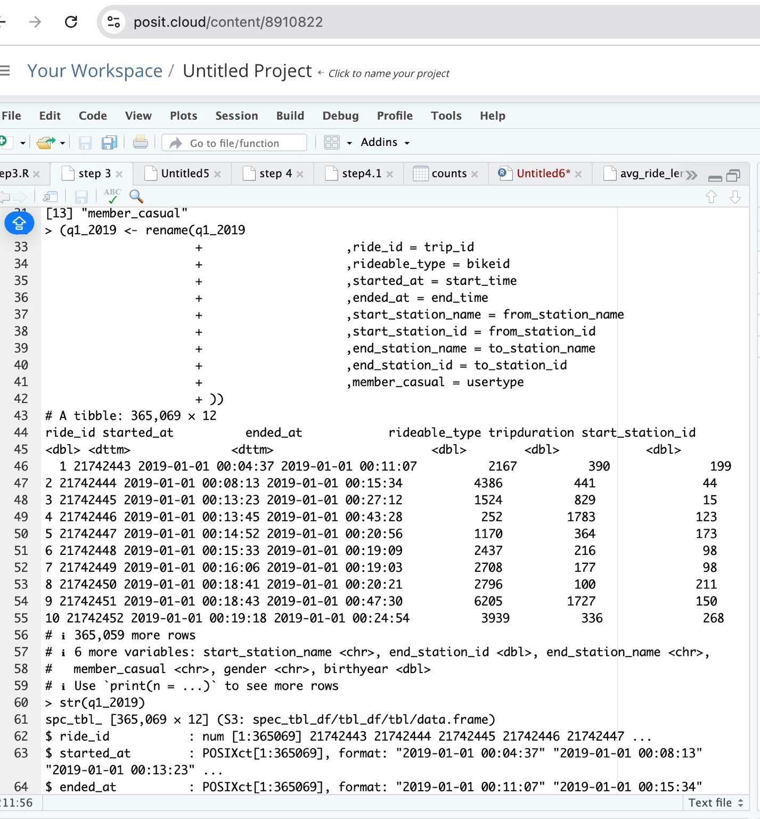

Slide 15
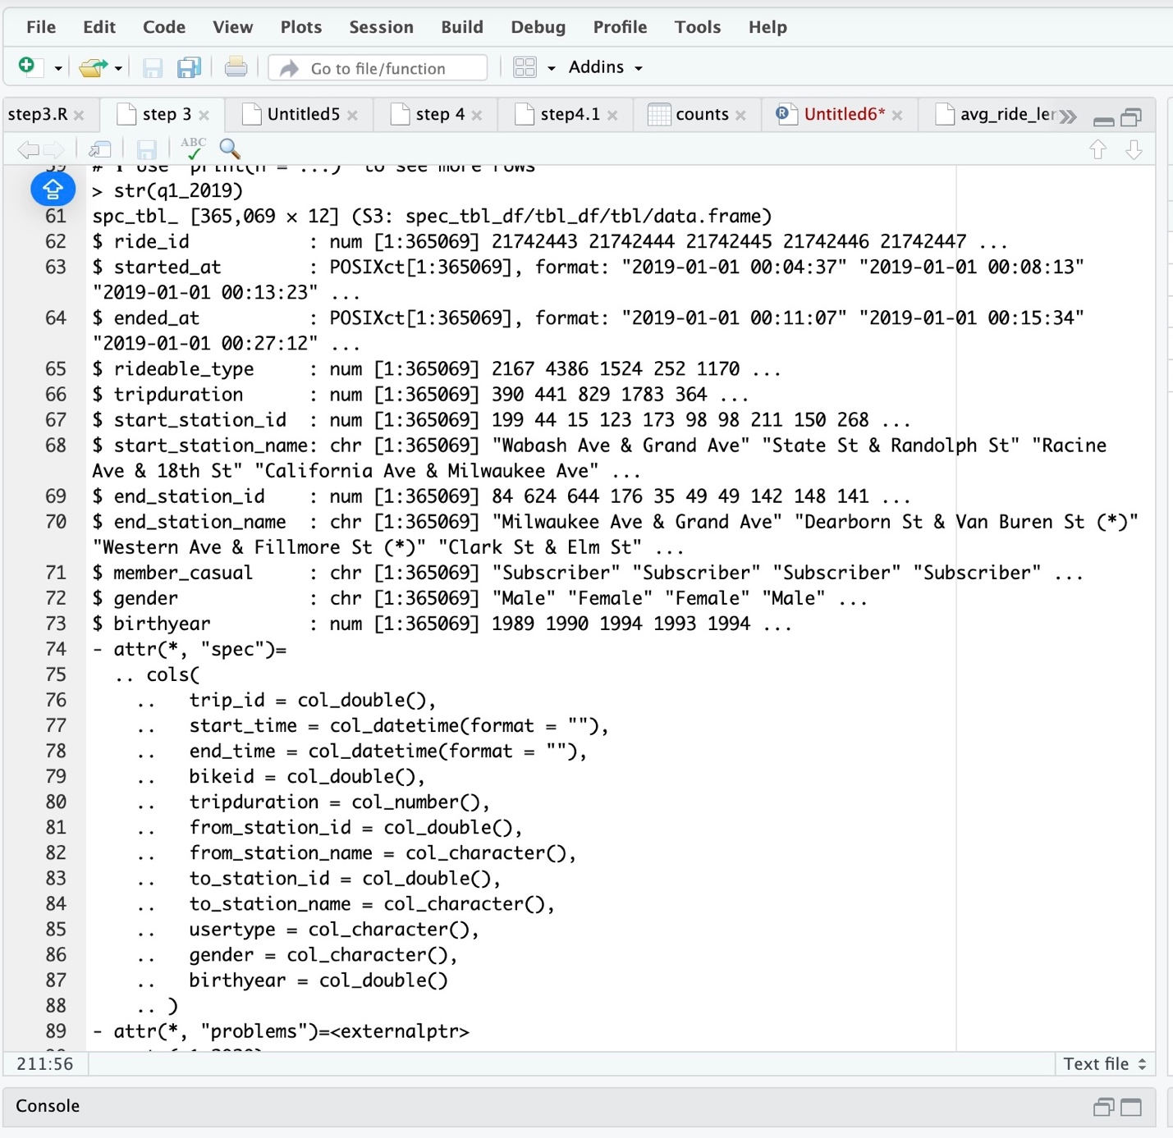
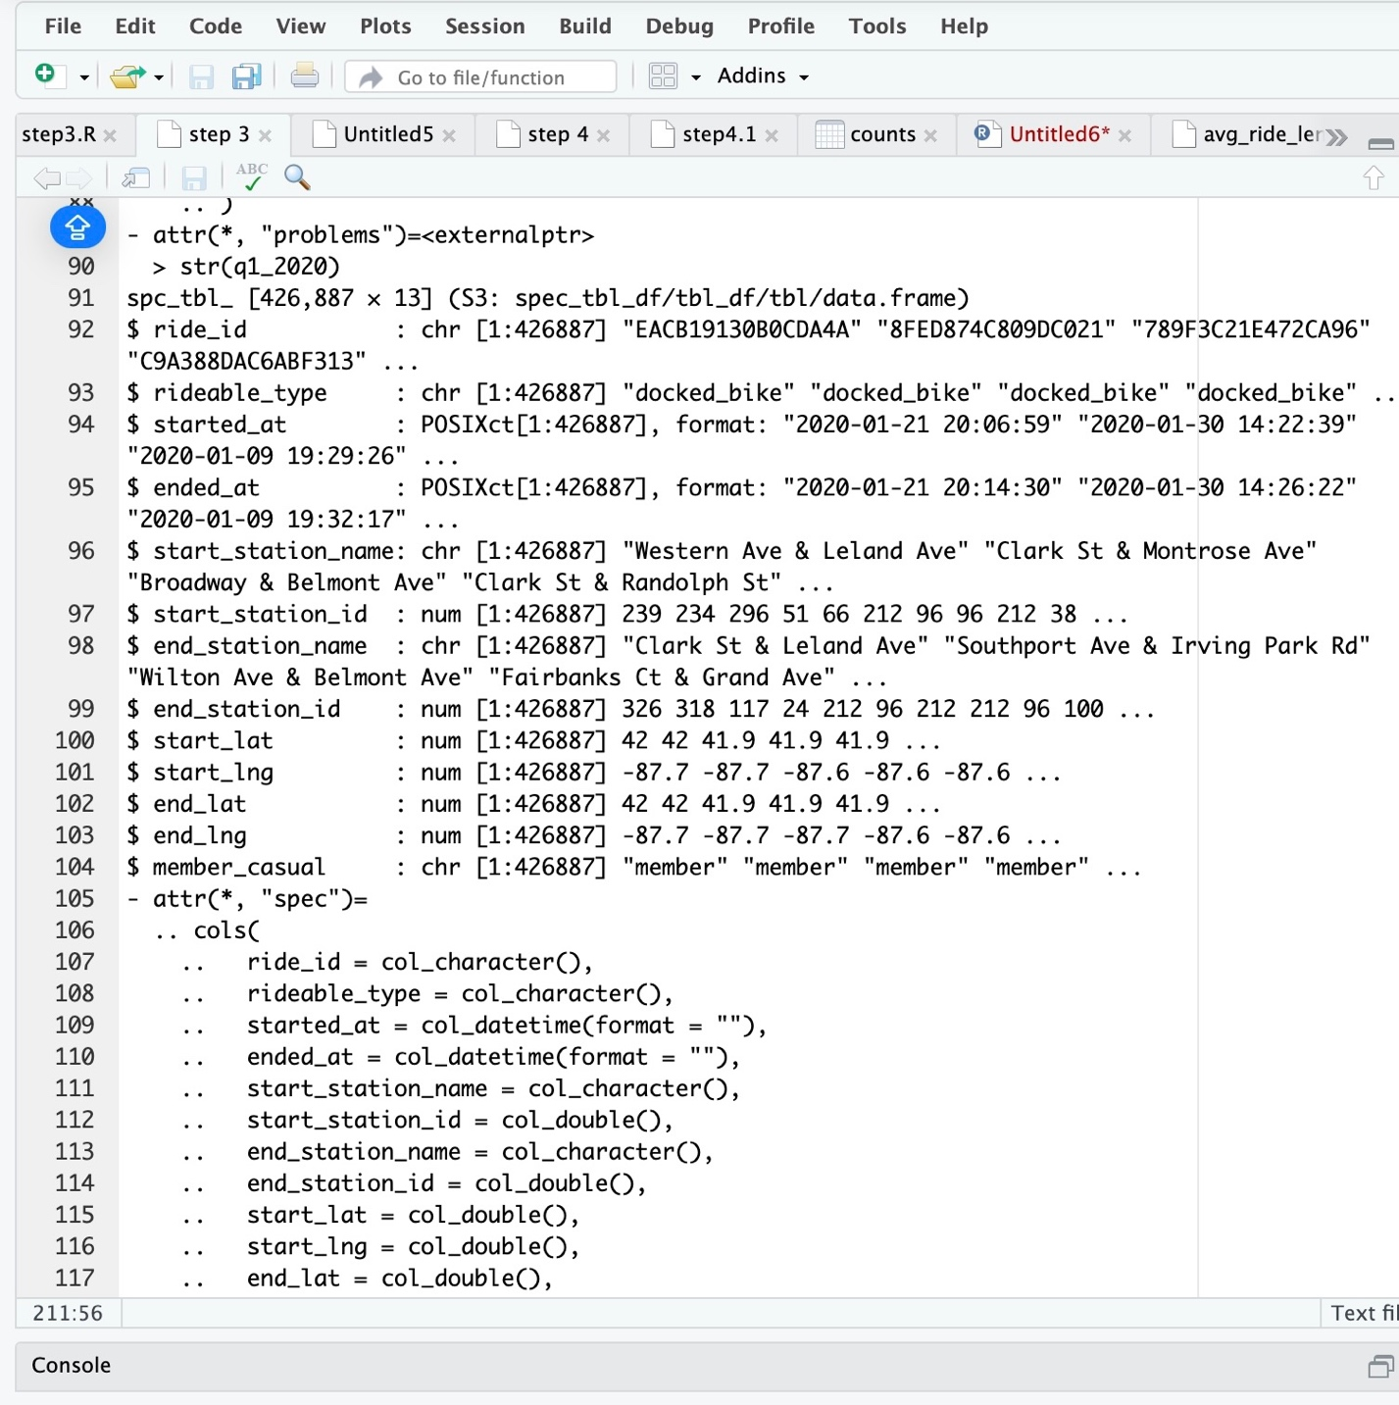

Slide 16
CLEAN UP AND ADD DATA TO PREPARE FOR ANALYSIS
In this step, we will clean the data before proceeding with the analysis. We will ensure there is no missing data and verify that the correct number of observations has been reassigned. We will also add columns for the date, month, day, and year. Additionally, we will remove any bad data, inspect the structure of the columns, and convert certain columns from factors to numeric types so that calculations can be performed. A new version of the data frame will be created. The following code below outlines the steps for these tasks.

Slide 17
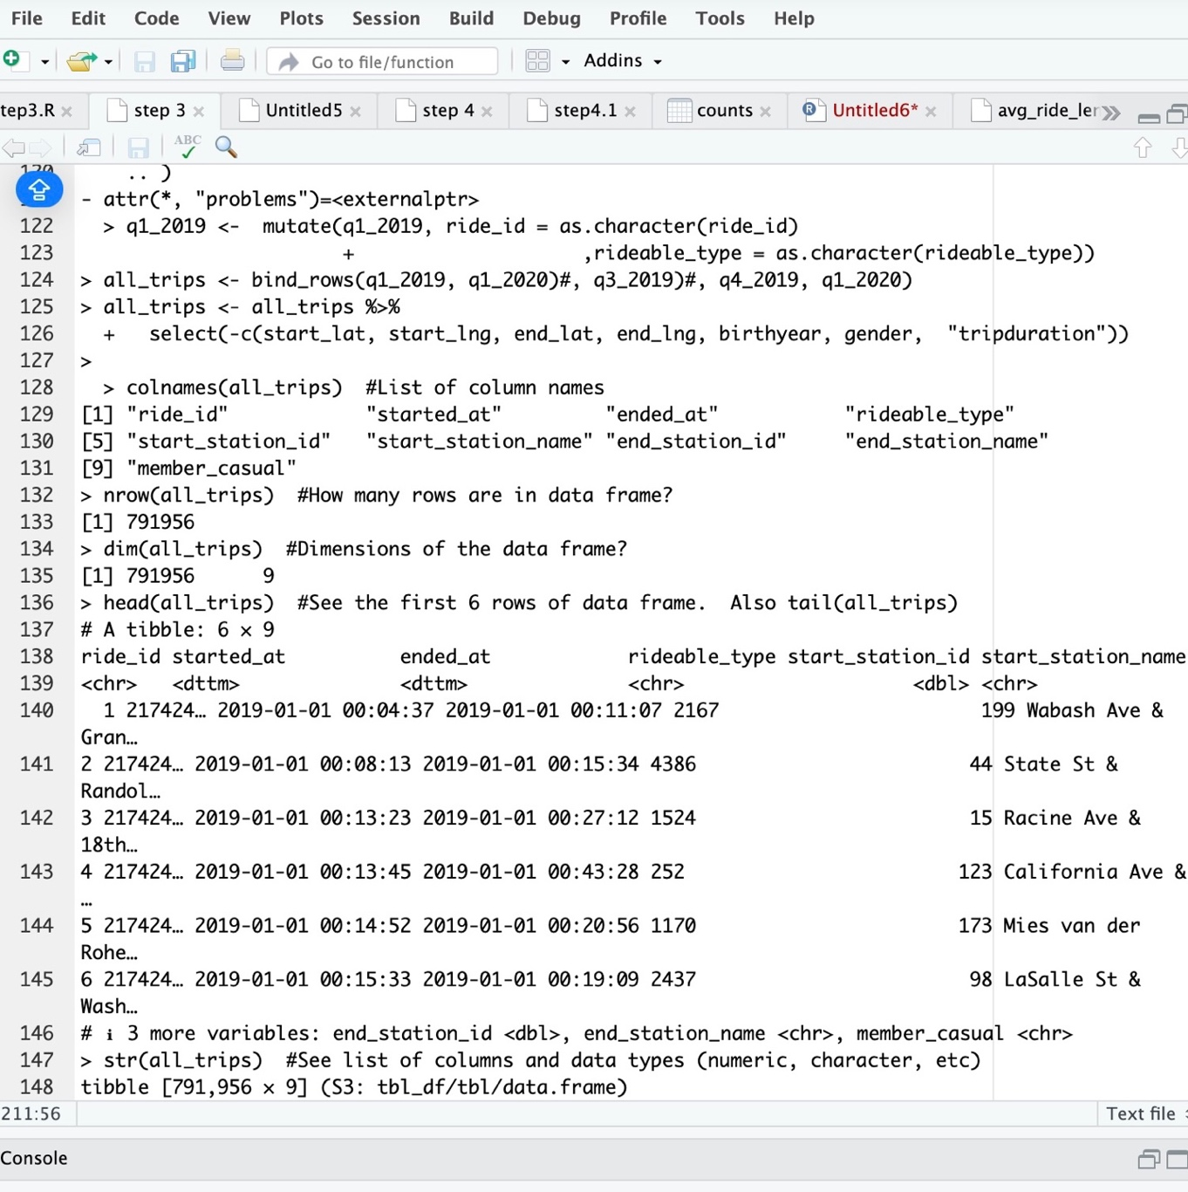
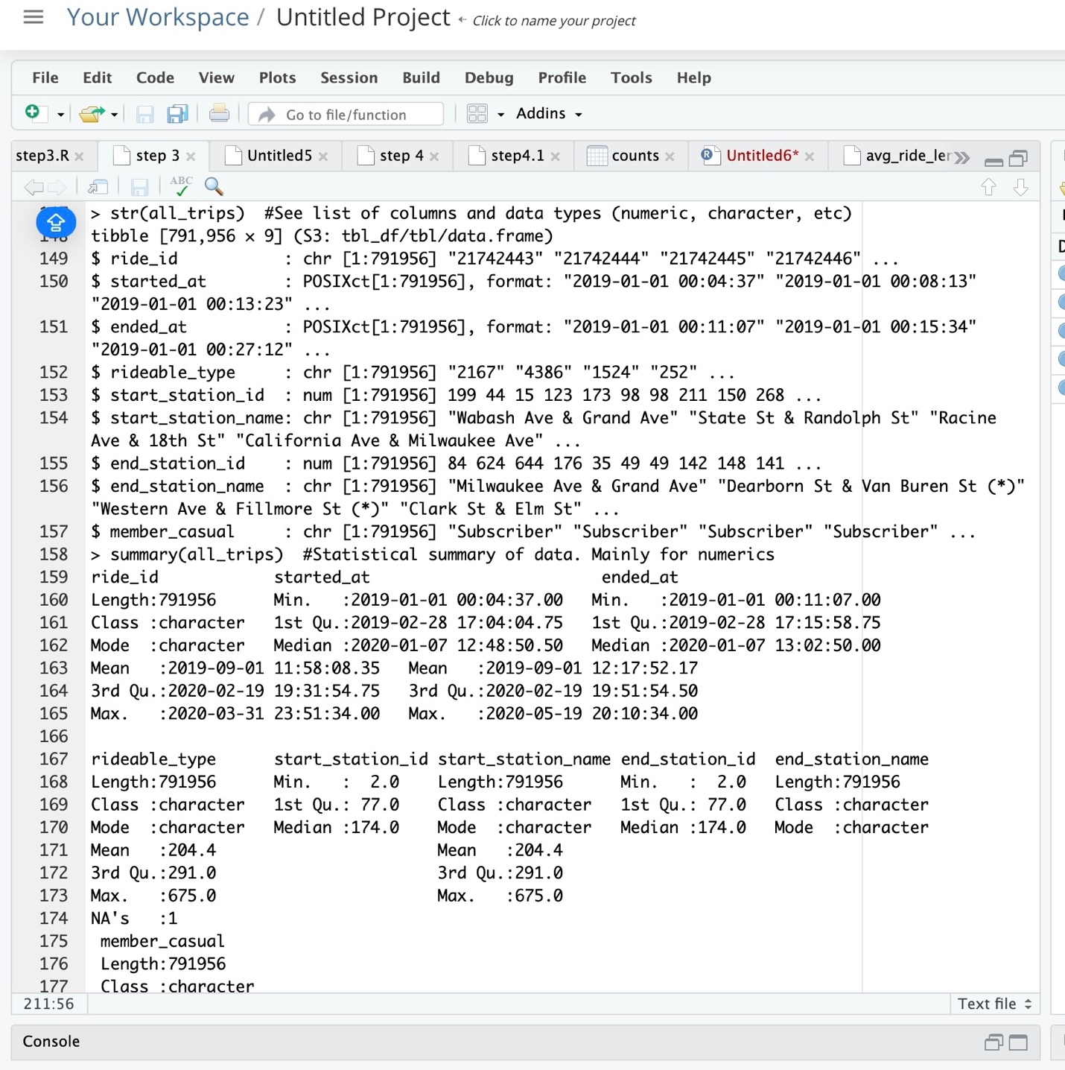

Slide 18
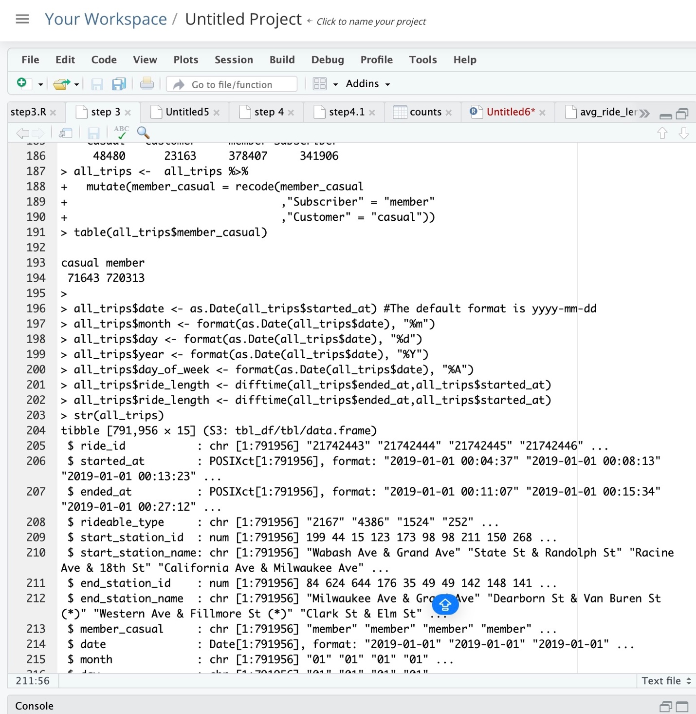

Slide 19
DESCRIPTIVE ANALYSIS
In this analysis, we will conduct a descriptive analysis of ride length by running the following codes. We will calculate measures of central tendency to determine the average ride time for each day, comparing members to casual users. Additionally, we will visualize the number of rides by rider type and create a visualization for the average duration of rides. All of the codes that we used are provided in the following figure.

Slide 20
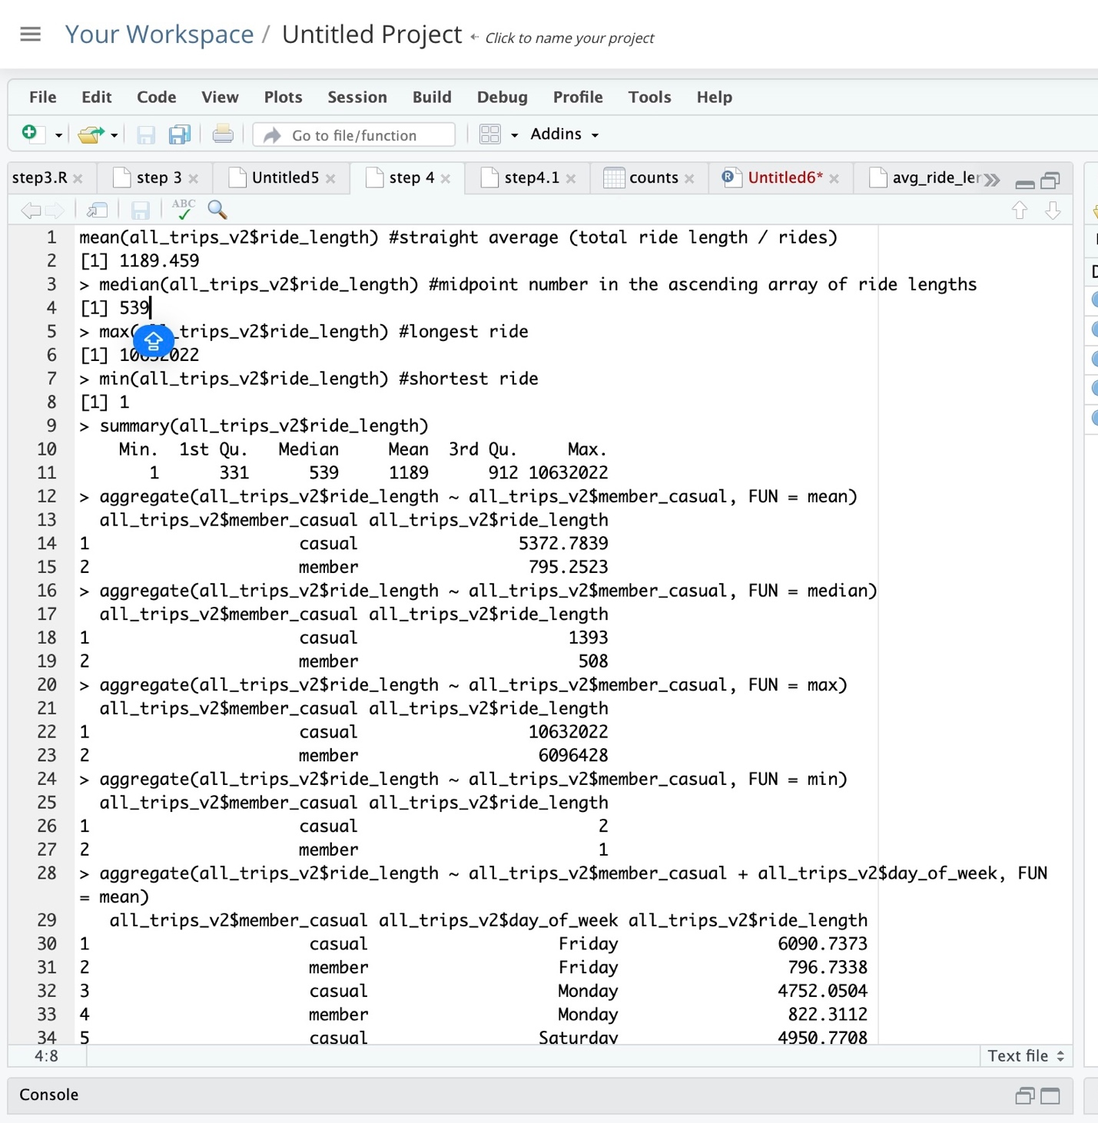
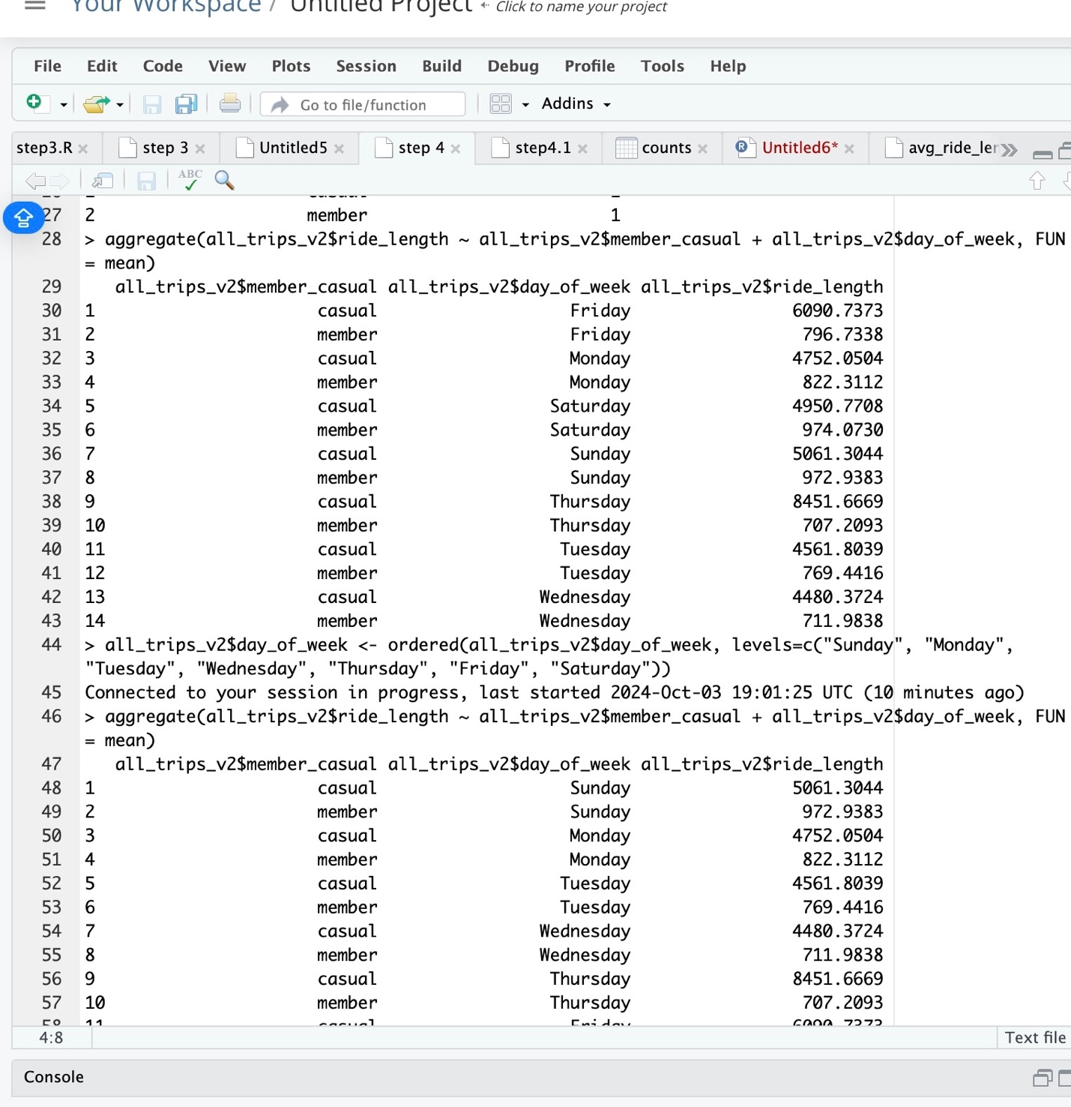

Slide 21
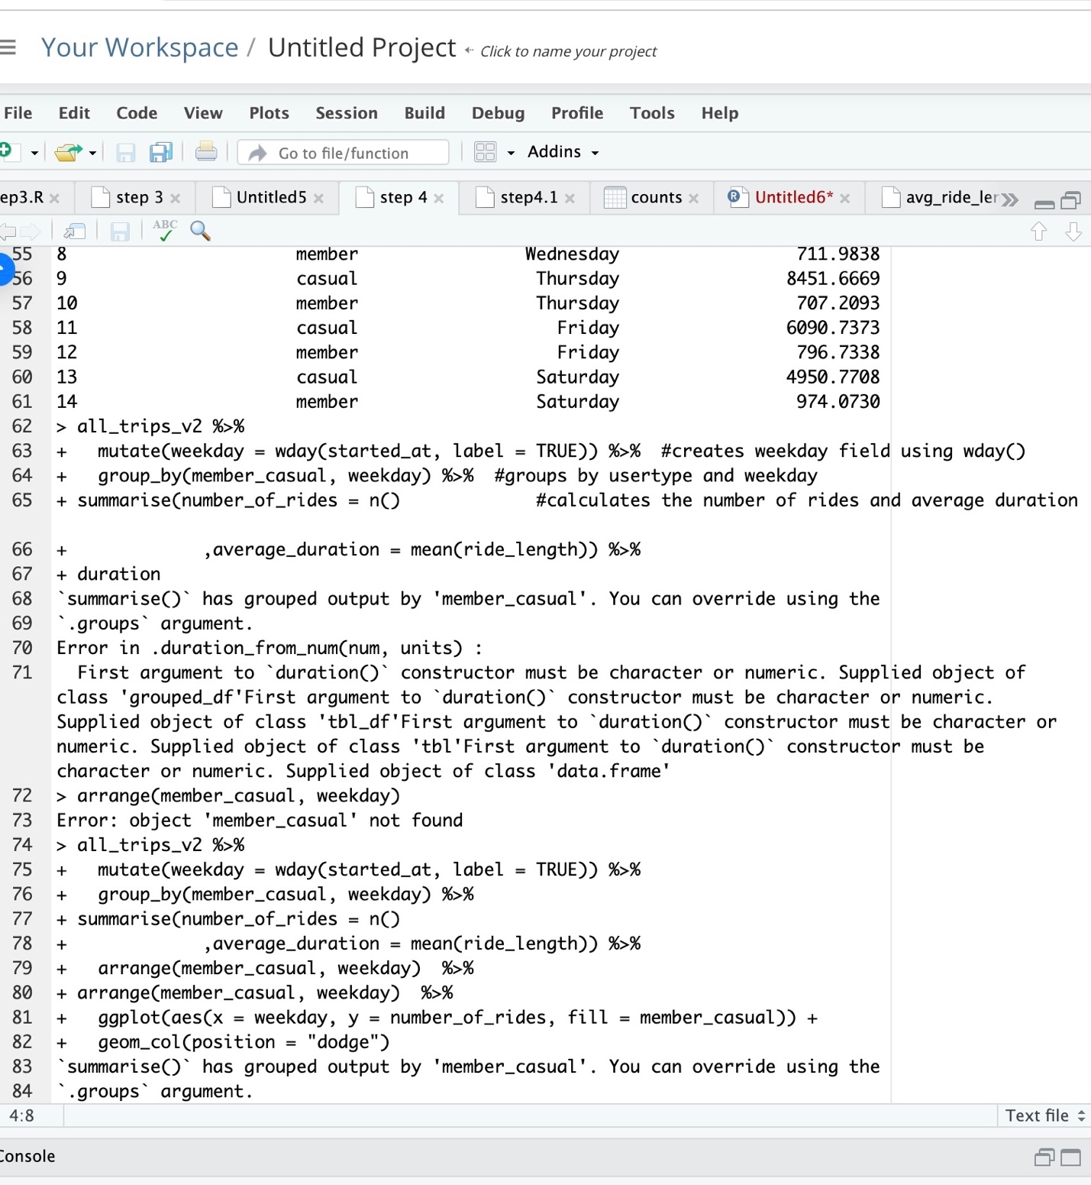

Slide 22
According to the data collected over twelve consecutive months between 2019 and 2020, the riding trends varied between members and casual users. Based on the different measures of central tendency calculated in Figures 1.7, 1.8, and 1.9, the average number of rides taken by casual users is significantly higher than that of members. In other words, casual rides account for an average of 87% of the total rides see table 1.1. Casual users tend to ride more on Fridays and Sundays, while member rides show a slight increase on Saturdays and Sundays. Most casual users prefer to ride on Fridays, although the difference is not substantial on Sundays. Conversely, members tend to ride more on Saturdays and Sundays. See Table 1.2
Why do members and casual users ride differently? Could it be due to their availability during weekdays or the price of rides? The difference is likely linked to the availability of customers, but it could also be influenced by variations in ride prices throughout the week, if any. Furthermore, why is there such a significant difference between the number of rides taken by casual users and members? Is it due to pricing differences, the frequency of rides during the week or months, or the benefits available to members that encourage them to join?

Slide 23
Depending on how the company treats its members, it may encourage casual riders to become members. The benefits offered by the company to its members are a primary reason why a casual rider might decide to join. Assuming the company sets ride prices at the same level for both casual riders and members, a non-member might still feel discouraged from becoming a member. This is likely because, rationally, an individual would not pay for an annual subscription if they do not perceive any advantages compared to being a casual rider.
If we assume that casual riders can take rides on their days off or whenever they have free time, regardless of the day of the week, and that they can enjoy the full benefits offered by the company at the same level as members, would this encourage them to join? Moreover, would current members continue to pay their subscriptions if they only ride during their free time? The answer may be no. The most effective way for a person to become a member and continue paying their subscription is through the benefits provided to new and existing members, ensuring they see value in maintaining their membership.

Slide 24
Table 1.1
mean(all_trips_v2$ride_length) #straight average (total ride length / rides)
[1] 1189.459
median(all_trips_v2$ride_length) #midpoint number in the ascending array of ride lengths
[1] 539
max(all_trips_v2$ride_length) #longest ride
[1] 10632022
min(all_trips_v2$ride_length) #shortest ride
[1] 1
summary(all_trips_v2$ride_length)
Min. 1st Qu. Median Mean 3rd Qu. Max.
1 331 539 1189 912 10632022
aggregate(all_trips_v2$ride_length ~ all_trips_v2$member_casual, FUN = mean)
all_trips_v2$member_casual all_trips_v2$ride_length
1 casual 5372.7839
2 member 795.2523
aggregate(all_trips_v2$ride_length ~ all_trips_v2$member_casual, FUN = median)
all_trips_v2$member_casual all_trips_v2$ride_length
1 casual 1393
2 member 508
aggregate(all_trips_v2$ride_length ~ all_trips_v2$member_casual, FUN = max)
all_trips_v2$member_casual all_trips_v2$ride_length
1 casual 10632022
2 member 6096428
aggregate(all_trips_v2$ride_length ~ all_trips_v2$member_casual, FUN = min)
all_trips_v2$member_casual all_trips_v2$ride_length
1 casual 2
2 member 1

Slide 25
Table1.2
Aggregate(all_trips_v2$ride_length ~ all_trips_v2$member_casual + all_trips_v2$day_of_week, FUN = mean)
all_trips_v2$member_casual all_trips_v2$day_of_week all_trips_v2$ride_length
1 casual Sunday 5061.3044
2 member Sunday 972.9383
3 casual Monday 4752.0504
4 member Monday 822.3112
5 casual Tuesday 4561.8039
6 member Tuesday 769.4416
7 casual Wednesday 4480.3724
8 member Wednesday 711.9838
9 casual Thursday 8451.6669
10 member Thursday 707.2093
11 casual Friday 6090.7373
12 member Friday 796.7338
13 casual Saturday 4950.7708
14 member Saturday 974.0730

Slide 26
Figure 1.10 the number of rides by rider type

Slide 27
Figure 1.11 The number of the rider by the average duration

Slide 28
Figure 1.12 All_trips_ride_length by day_of_week

Slide 29
Figure1.13 all_trips_ride_length_day_of_week

Slide 30
Figure 1.14 Casual vs. all_trips_day_of_week

Slide 31
Figure1.15 casual and member all_trips_ length by day_of_week

Slide 32
Figure 1.16 Casual, member, and grand Total all_trips_length by day_of_week

Slide 33
An increase in memberships would be an important measure for the company to facilitate the process for people to become members. One way that Cyclistic can increase memberships is by using digital media to influence casual riders to join. To encourage casual riders to become members, Cyclistic can provide discounts during specific times of the day or month exclusively for members, create an app that allows riders to establish profiles with information such as age, gender, occupation, and geographic location, and design a loyalty program specifically for casual riders. Additionally, launching a campaign to boost member usage during less popular months could be beneficial. These are some common strategies Cyclistic can employ using digital media to influence casual riders to become members and increase the overall membership numbers

Slide 34
CONCLUSION AND RECOMMENDATION
After analyzing the data collected between 2019 and 2020, we found that casual riders and members use Cyclistic bikes differently. On average, casual riders account for 87% of all rides, indicating that non-members use the bikes significantly more than members. This finding contrasts with our initial hypothesis that “annual members use the service more frequently than casual riders because the prepaid subscription encourages them to take rides more often than if they didn’t have an annual membership.” The number of rides varies depending on the day of the week, with many casual riders preferring to use Cyclistic bikes from Thursday to Sunday. In contrast, members tend to ride primarily on Saturdays and Sundays. The highest number of casual rides occurs on Thursdays, while the majority of member rides take place on Sundays.
As we mentioned in our second hypothesis, “Cyclistic could introduce a subscription model that is easy to customize and flexible, offering price reductions or promotions for new users,” the benefits offered by Cyclistic are the primary reasons casual riders might choose to become members. Discounts on certain days, especially during weekends, could incentivize casual riders to join Cyclistic. The company could leverage digital media to influence casual riders to become members while offering benefits such as:

Slide 35
A self-service bike program can succeed quickly if the marketing manager implements strategies that encourage casual riders to become members and motivate current members to pay for subscriptions. Based on the data analyzed and our observations of the various trends in Cyclistic bike usage, we can make specific recommendations to help the bike-share navigate rapid success by using digital media:
Highlight the benefits of membership and why casual riders might be unaware of them. Provide discounts for Saturdays and Sundays, as these are the days when members use Cyclistic bikes more often.
Conduct marketing campaigns at tourist and recreational locations.
Offer membership benefits, including at least one free Saturday or Sunday each month.
Create an app that allows riders to establish profiles with information such as name, age, gender, occupation, and location.

